Slide 1

FAIL
FIRST
AND
FAIL
HARD

Slide 2
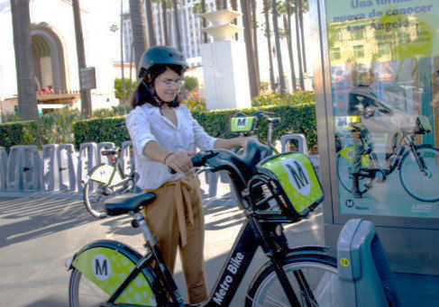
When is Bike Sharing in LA Popular?
Jennifer Collins
Ellen Hendricks
Sarah Small

Slide 3
Motivation and Summary
With the growth of Bike Sharing programs across the country, we are interested in analyzing the trends in bike sharing programs to determine what measurable factors influence ridership. If we started a bike sharing program, what trends could we use to determine our success?
How has ridership increased over time?
Does business increase or decrease over the weekends?
What part of the day sees the most rides?
Do weather conditions or air quality affect ridership?
How does this compare to longer established program in NYC?
What types of rides (passes or walk-up) are used the most?
Analyze data from MetroBike in Los Angeles, looking for trends in daily and monthly rides from 2016 and 2017, as the program was opened to the public and established over time.
Acquired data from data.gov and the MetroBike website data page, which required standardizing data formats.
Intended to analyze the ridership numbers in relationship to weather conditions, but only had time for general seasonal trends. We were unable to acquire data for air quality conditions.
Overall, we determined that we have more questions now than when we began this project.

Slide 4
Data Cleanup and Exploration
The MetroBike ride data for 2016 was sourced from data.gov, and the data for 2017-2018 was sourced from the MetroBike website https://bikeshare.metro.net/about/data/
There were some minor differences between our source data, like headings, but the main problem was the ride start time formatting. The data.gov start times were easily converted to a datetime object. However the Metrobike data start times were not zero padded, and a custom function was written to add the zeros. After this was done, the start time could be converted to a datetime object, therefore standardizing our data across the years.
We also had to standardize the time frames from our data sets, as the data.gov information covered 7/16/2016 to 3/17/2017. The MetroBike data was divided into quarters covering all of 2017 through Q1 of 2018. This required splitting the data.gov information into quarters for consistency.
Finally, pandas seemed to have trouble with some of the Lat/Lon data for station locations. Those columns were removed because they were not going to be used in our initial analysis, and were not consistently represented between our two data sources, either. This is something we would like to include upon further analysis.

Slide 5
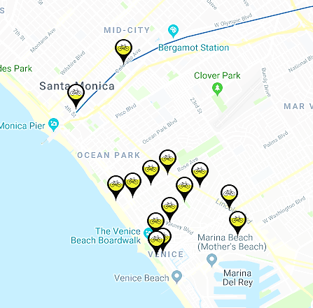
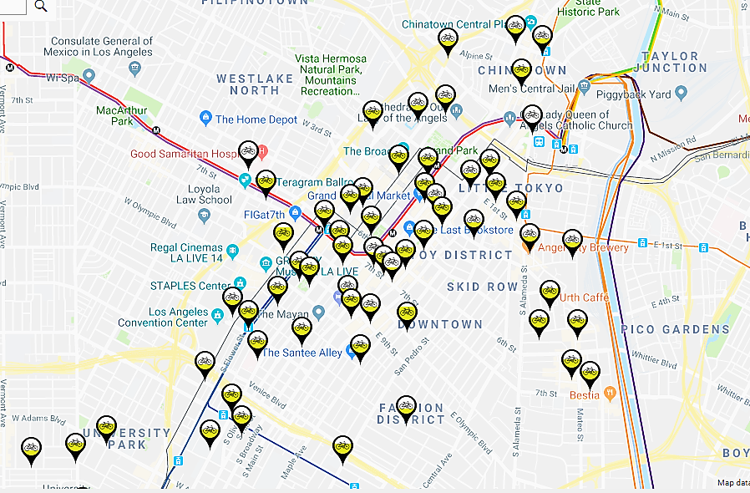
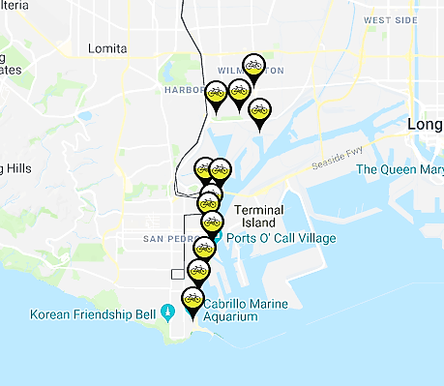
Metro Bikeshare area bike dock maps
Santa Monica and Venice Beach
Downtown Los Angeles
Coast/ Port area

Slide 6
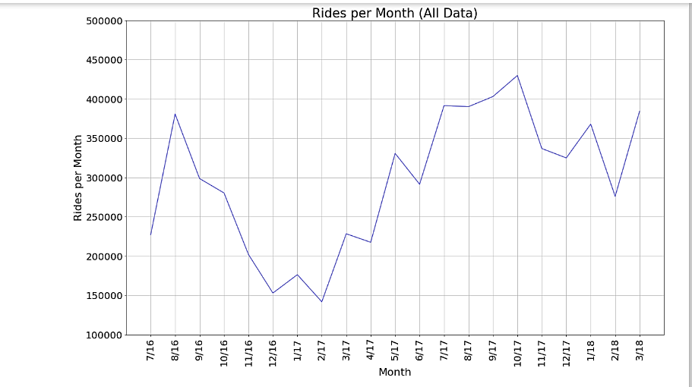
Hypothesis 1: Ridership has increased steadily over time following the opening of business in 2016. Null Hypothesis: Ridership has not shown a steady increase over time.

Slide 7
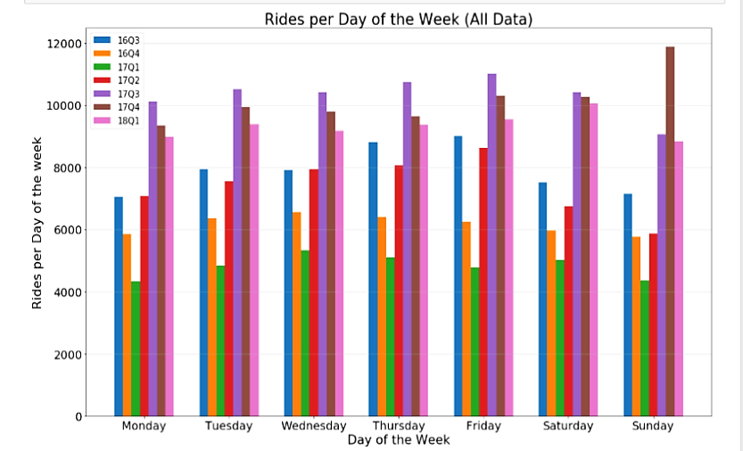
Hypothesis: Bike sharing riders use the system differently depending on the day of the week. Null hypothesis: Day of the week has no effect on total ridership.

Slide 8
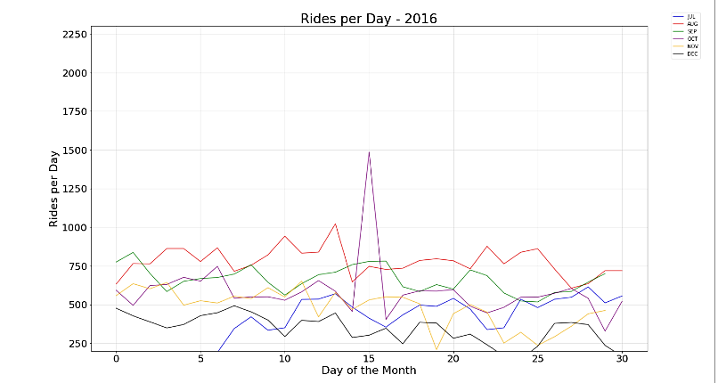
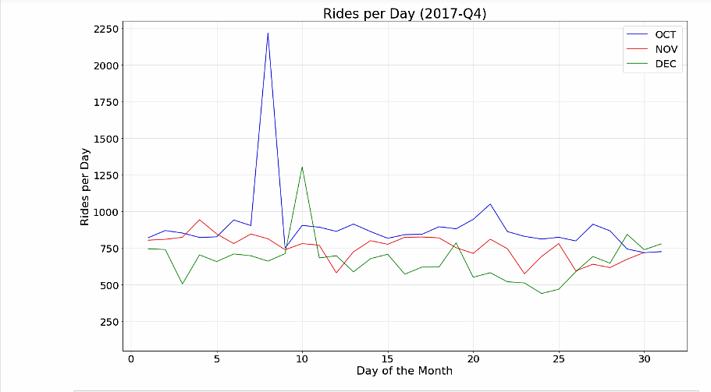
Notable trends: Why is there a large spike during October in both 2016 and 2017?
http://www.welikela.com/event/ciclavia-heart-la-10-16-2016/
This is an annual event billed as a free street party that restricts road usage to pedestrians and bicycle traffic. Research shows that the festival for 2018 is scheduled for September 30, 2018.

Slide 9
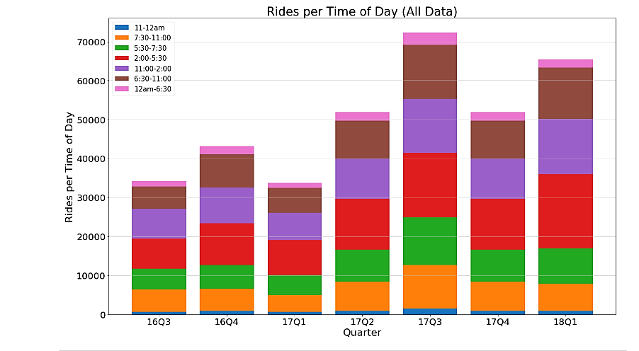
Hypothesis: Bike sharing riders use the system more during certain times of day (i.e. for commuting). Null hypothesis: Time of day does not affect rate of ridership.

Slide 10
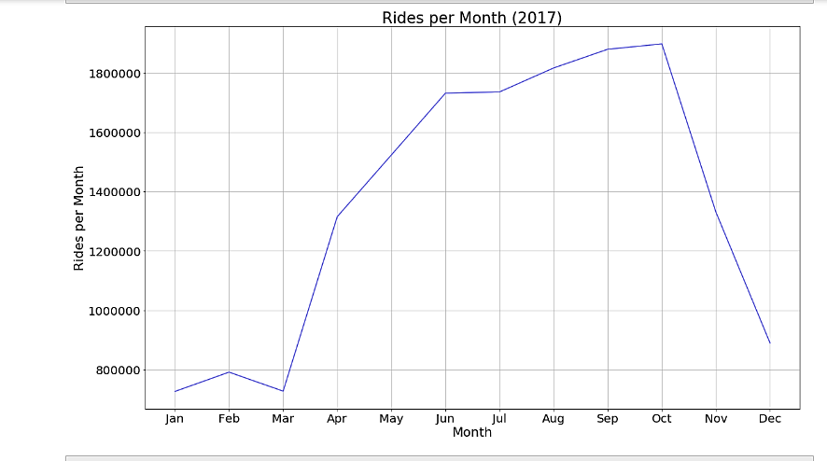
Fun with other data sets
We analyzed a small amount of data from the CitiBike program in New York City that has been running for more than a decade. This data was only available in a total rides per day format, so meaningful comparison to MetroBike in Los Angeles was not possible.

Slide 11
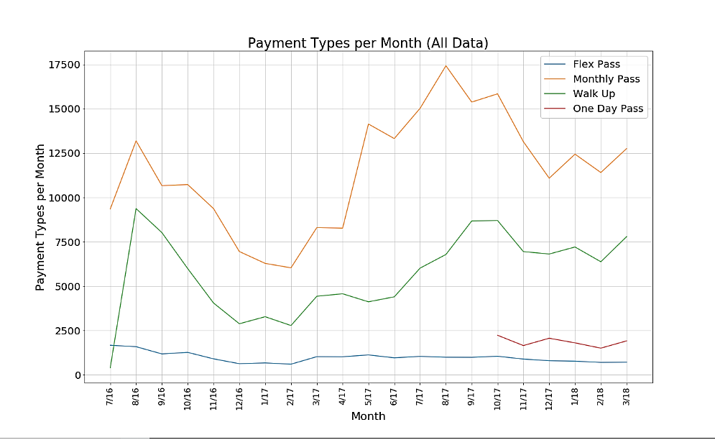
Are more rides purchased through passes or walk-up business?

Slide 12
Further Questions to Explore
Do weather conditions affect ridership rates?
In L.A., where weather is relatively steady, it was hard to determine if this had an effect. When viewing weather vs. ridership in NYC, there was a plummet during the winter months. Slight declines were noted in our LA data with less of a decline in 2017-2018 than in 2016-2017? Was this due to a milder winter or a longer running program?
How does tourism affect ridership?
With more time, we would like to study the effect of tourism seasons and usage by station location to determine how much of the spike in afternoon ridership is attributable to self guided tourism.
Is there a way to explore factors like bike safety and ‘bike culture’ in analyzing bike sharing program success? We discovered articles about a lack of safety for bicycle users in Los Angeles.
https://la.curbed.com/2018/7/2/17528250/lebron-james-lakers-los-angeles-biking
“The number cyclists and pedestrians killed on LA’s streets has risen sharply. From 2013 to 2017, 489 walkers and cyclists were killed on LA’s streets. In some underserved communities, the increases are even more dramatic. In some parts of South LA, for example, collisions that involve bikes have increased by 70 percent.”

Slide 13
1. Track daily total usage over time in LA to get started.
2. When is the most popular time of day for shared bike usage? Most popular day of the week?
3. Does temperature, precipitaiton, or air quality have an impact on number of daily rides?
4. Does the type of fare paid affect when bikes are being used?
Hypothesis 1: Ridership has increased steadily over time following the opening of business in 2016.
Null Hypothesis: Ridership has not shown a steady increase over time.
Hypothesis 2:
Bike sharing riders use the system differently depending on the day of the week.
Null hypothesis: Day of the week has no effect on total ridership.
Hypothesis 3:
Bike sharing riders use the system more during certain times of day (i.e. for commuting).
Null hypothesis: Time of day does not affect rate of ridership.
Notes:
Do not use during slideshow/presentation….this was for working out questions/hypotheses.

Slide 14
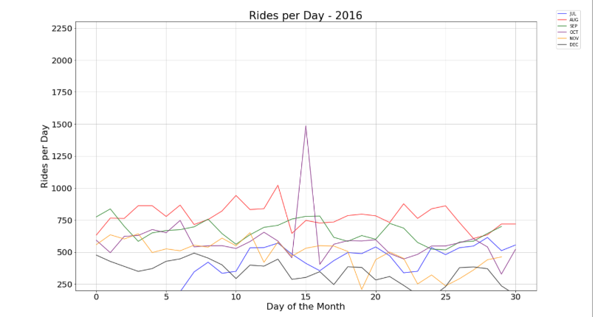
How has total ridership increased over time from the launch of the program in 2016 through 2017?
Use MetroBike data to chart the total number of rides per day for 2016
Use MetroBike data to chart the total number of rides per day for 2017
Need to make combined 2017 Q3-Q4 chart to match 2016 chart…add here!
Notes:
Ditching slide to use overall line graph from start of 2016 data through all of 2017 data

